Slide 2

Background
The SDN Controller manages the Control Plane for the Network.
In big Datacenters one of the major concern is to provide high-availability of the Controllers. Providing resiliency in case of failure and Auto Scaling of Controller Application in case of overloaded conditions.

Slide 3

Goal
The goal of this project is to provide an efficient platform for SDN Controller Application to be Highly-Available, Auto-Resilient and can be Scaled on the run.

Slide 4

Solution
By deploying and running SDN Controller Application as a Microservice inside a POD in Kubernetes Platform.

Slide 5
Objectives
Setting-up Kubernetes Cluster: The primary objective is to set-up the kubernetes Cluster in order to start with the deployment of application.
Creating the SDN Controller Deployment: The next objective requires to build a deployment manifest which will ensure the requirements of running the Controller Application. This includes controller application image selection, number of replicas, any node selection etc.
Creating Service for the Deployment: To ensure the continuous accessibility of Controller application to the outside world, service creation is required which will ensure the unbroken connection and high-availability.

Slide 6
Overview
Kubernetes is an Open Source system that automate deployment, scaling and management of Containerized application

Slide 7
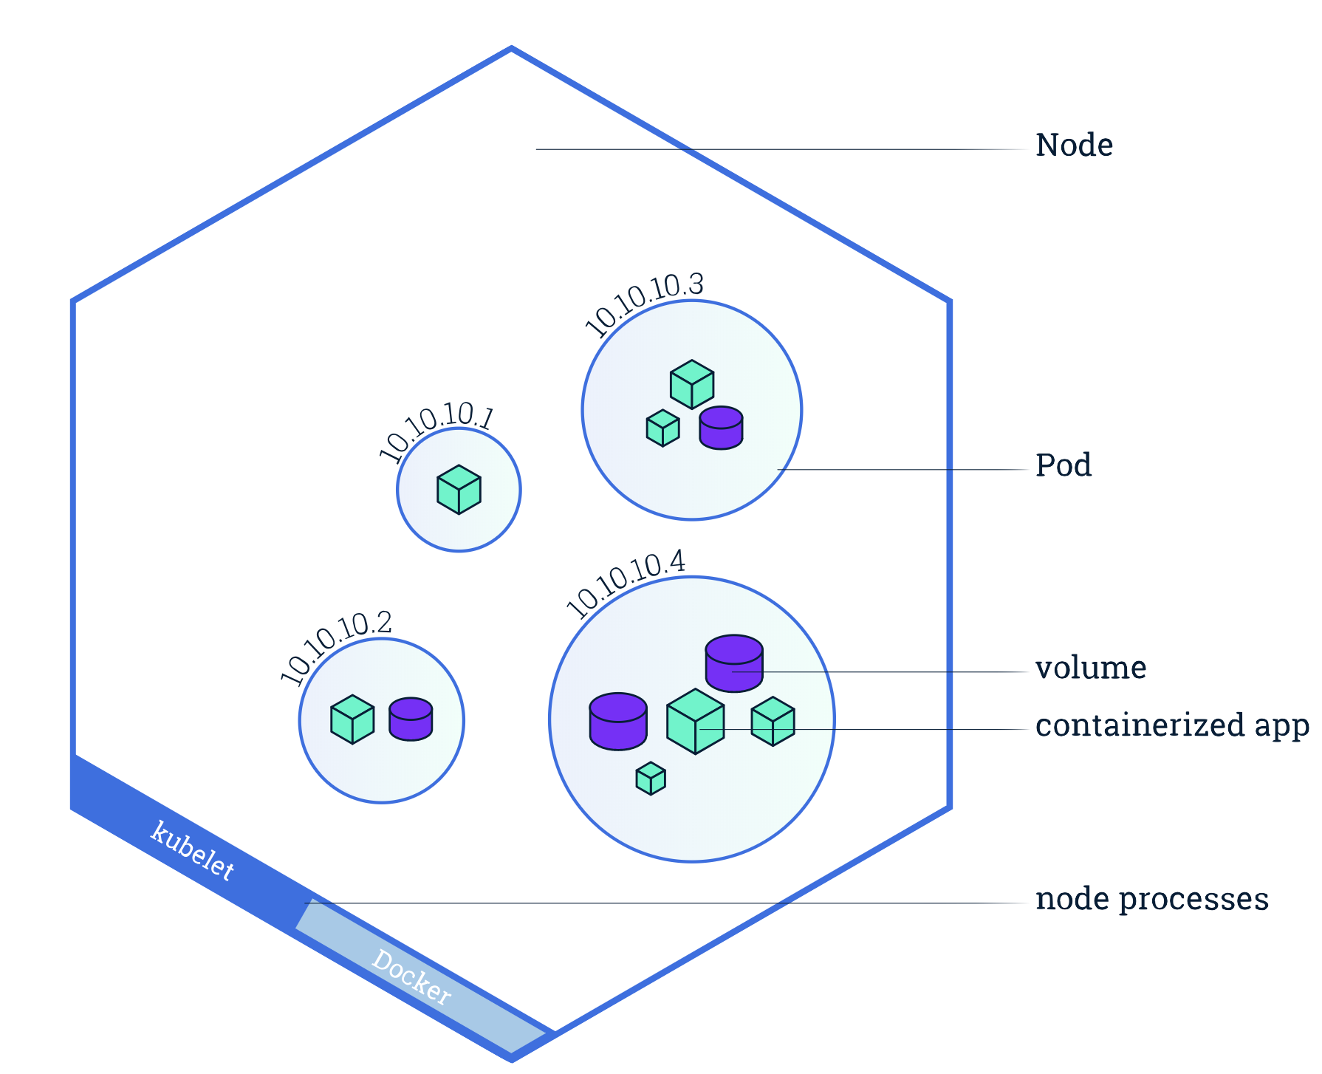
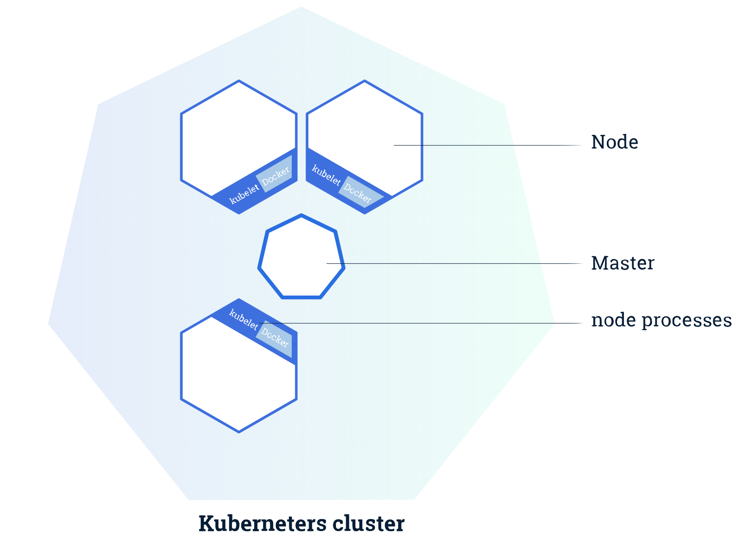
Component Diagram – K8s Cluster

Slide 8
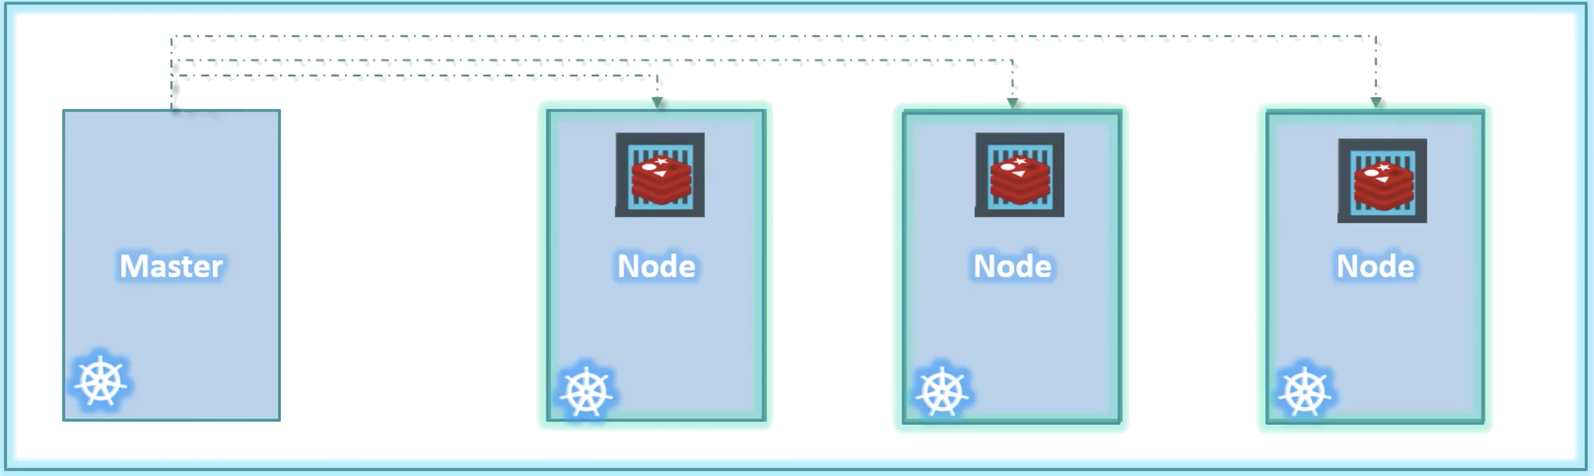
Component Diagram – K8s Deployment

Slide 9
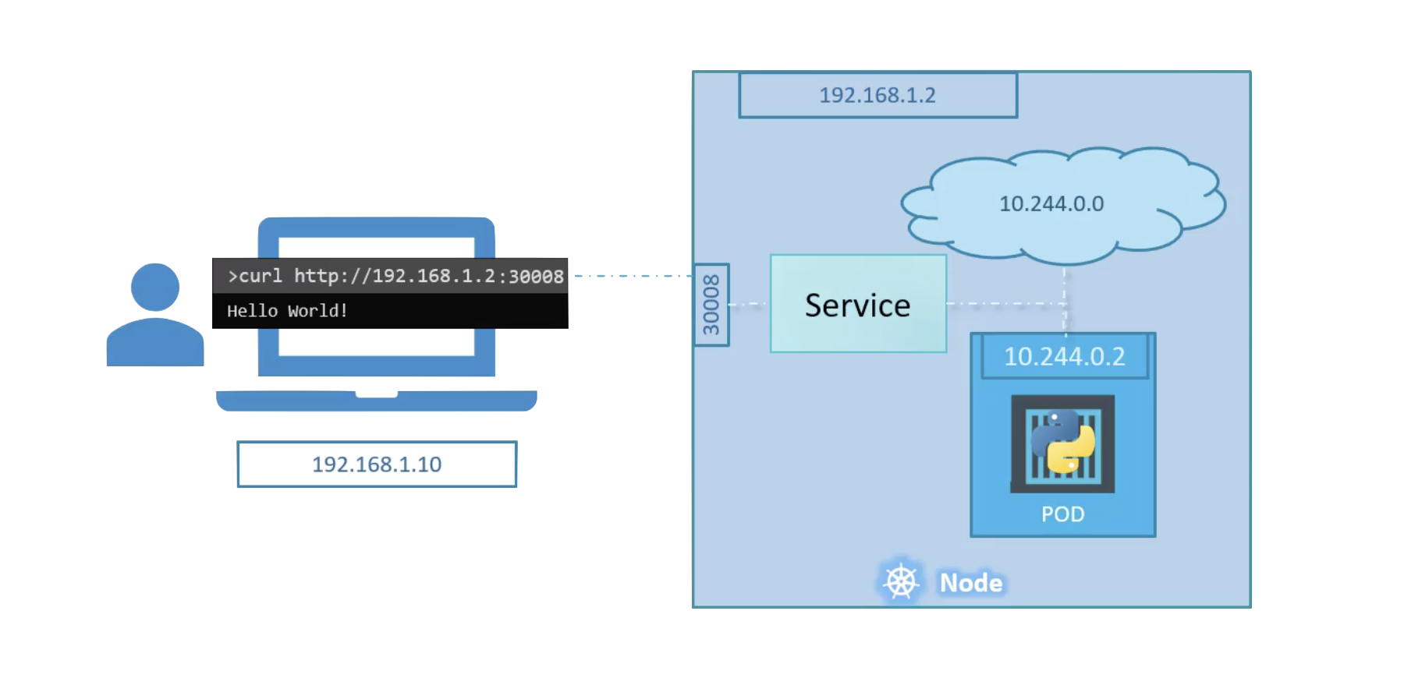
Component Diagram – K8s Service

Slide 10
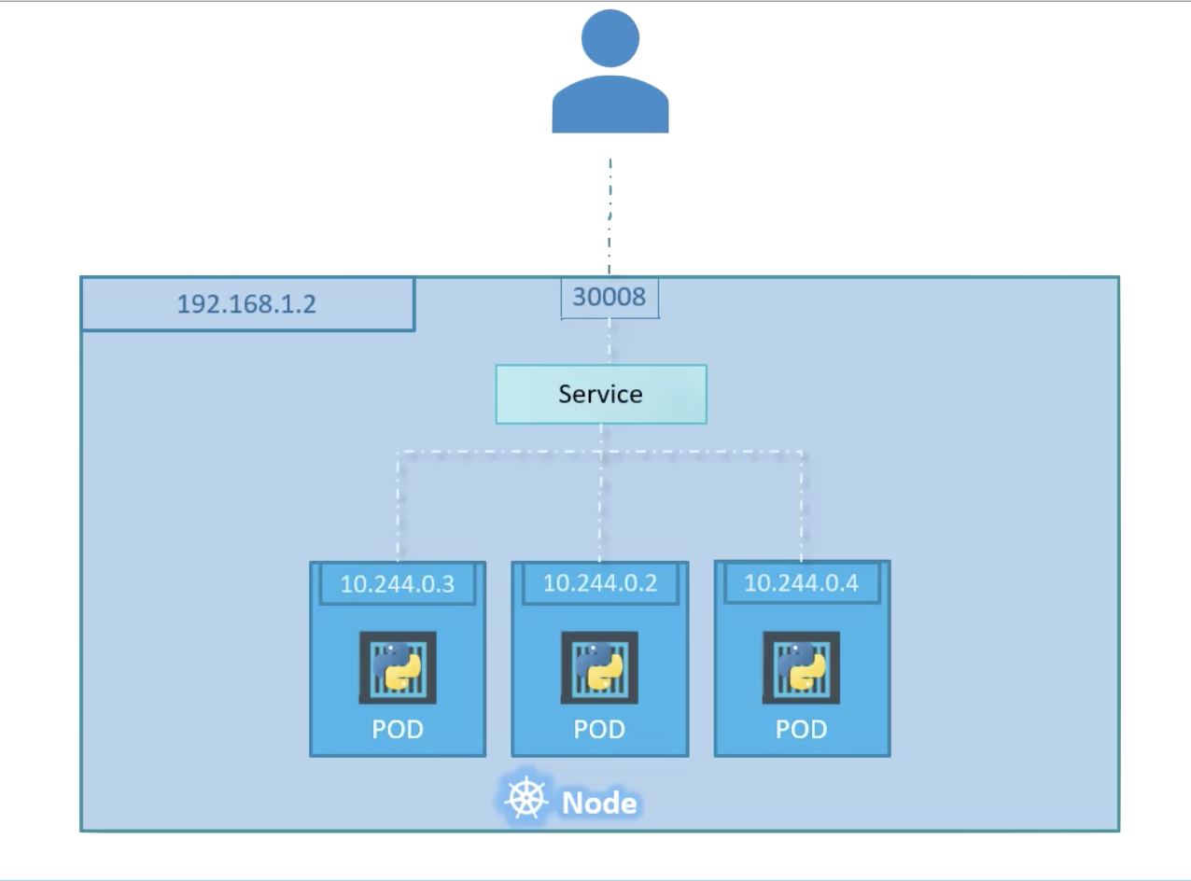
Component Diagram – K8s Service

Slide 11
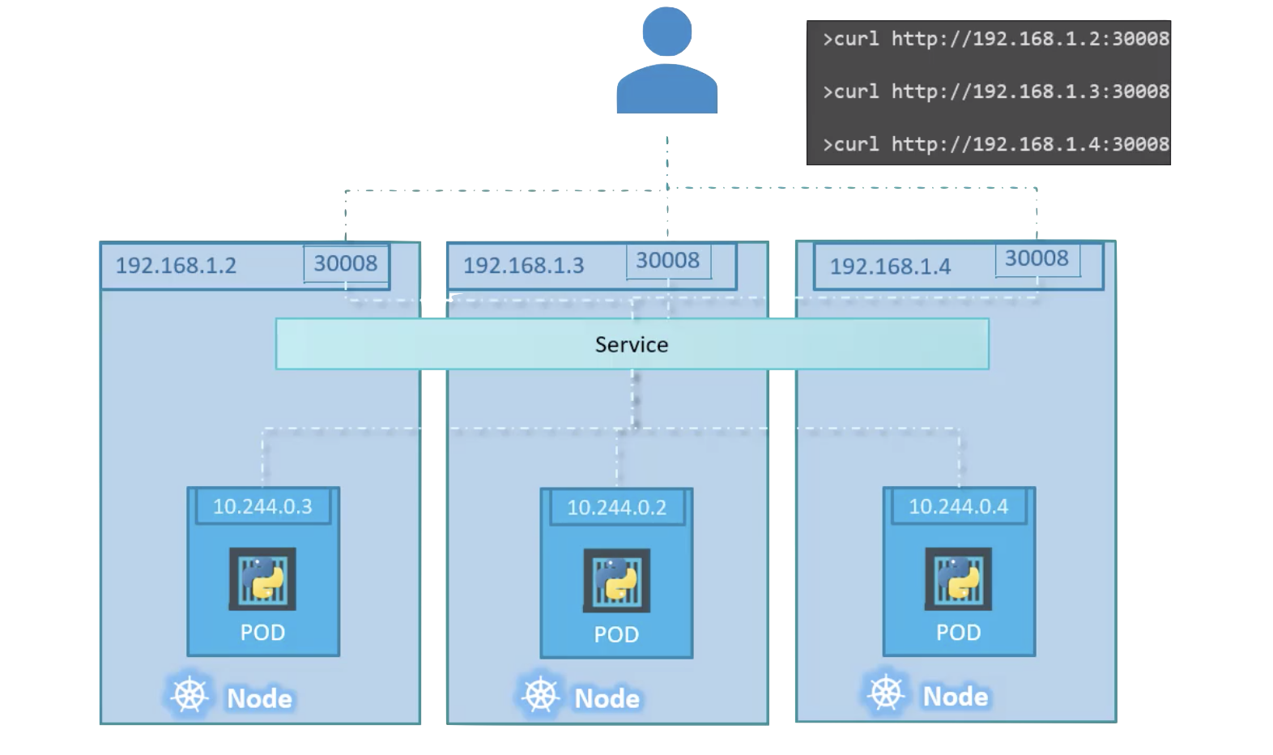
Component Diagram – K8s Service

Slide 12
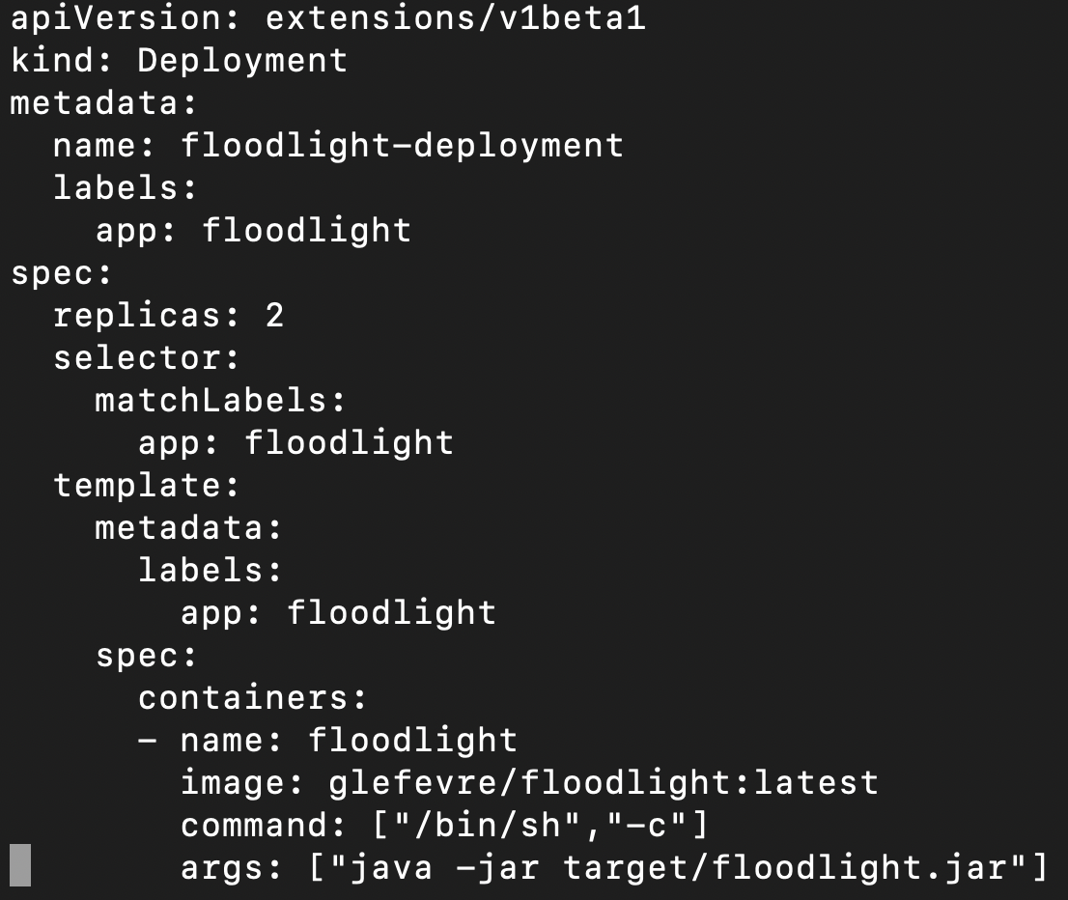
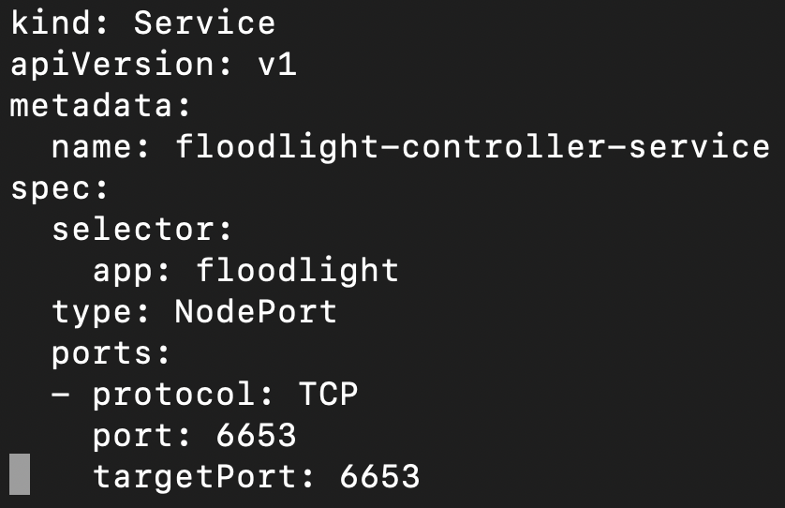
YAML

Slide 13
DEMO

Slide 15


